Slide 1

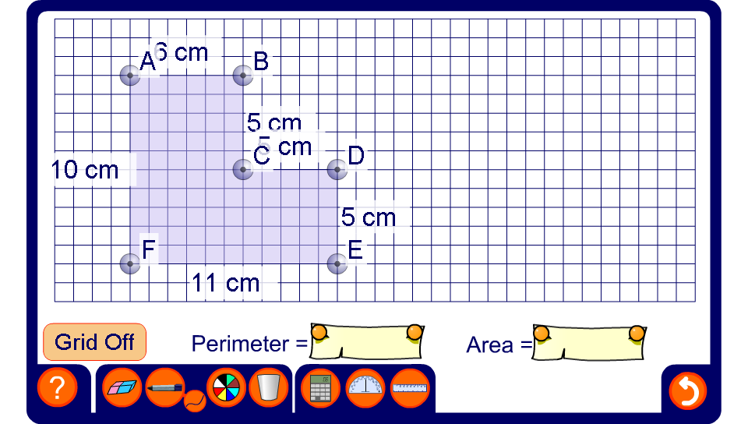


Shapes made from rectangles
Notes:
Modify the compound shape on the board and discuss the various ways to find its area by splitting it into two rectangles or by subtracting a rectangle.
Turn off the square grid and hide the lengths of some of the sides by clicking on them. Discuss how the lengths of these missing sides can be found and use these lengths to find the perimeter and the area.

